Slide 1
어셈블리어 Intro_2 보조
-MinGW, nasm 설치

Slide 2
목차
MinGW 설치
nasm 설치

Slide 3
MinGW
Introduction
  a contraction of "Minimalist GNU for Windows", is a minimalist development environment for native Microsoft Windows applications.
  provides a complete Open Source programming tool set which is suitable for the development of native MS-Windows applications, and which do not depend on any 3rd-party C-Runtime DLLs
  provide access to the functionality of the Microsoft C runtime and some language-specific runtimes.

Slide 4
MinGW
Include
  A port of the GNU Compiler Collection (GCC), including C, C++, ADA and Fortran compilers;
  GNU Binutils for Windows (assembler, linker, archive manager)
  A command-line installer, with optional GUI front-end, (mingw-get) for MinGW and MSYS deployment on MS-Windows
  A GUI first-time setup tool (mingw-get-setup), to get you up and running with mingw-get.

Slide 5
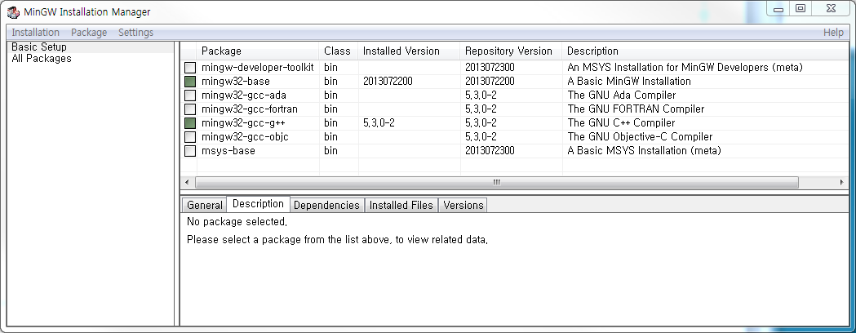
MinGW
Installation
  download mingw-get-setup.exe at https://sourceforge.net/projects/mingw/files/Installer/
  base와 g++ 선택 후 Installation->Apply Changes

Slide 6
MinGW
Installation
  제어판 -> 시스템 및 보안 -> 시스템 -> 고급 시스템 설정
  환경변수 -> 시스템변수 -> Path -> 편집
  C:\MinGW\bin 추가
  cmd 열어서 gcc 실행 확인

Slide 7
목차
MinGW 설치
nasm 설치

Slide 8
Netwide Assembler, NASM
Introduction
  an assembler and disassembler for the Intel x86 architecture.
  used to write 16-bit, 32-bit (IA-32) and 64-bit (x86-64) programs
  considered to be one of the most popular assemblers for Linux.
  Output binary formats
    COFF, Portable Executable, a.out, Executable and Linkable Format (ELF), Mach-O and binary file (.bin, binary disk image, used to compile operating systems)

Slide 9
Netwide Assembler, NASM
Introduction
  run on non-x86 platforms, such as PowerPC and SPARC, though it cannot generate programs usable by those machines.
  uses a variant of Intel assembly syntax instead of AT&T syntax.

Slide 10
Netwide Assembler, NASM
Installation
  download nasm-2.12.02-installer-x86.exe at http://www.nasm.us/
  설치 진행
  제어판 -> 시스템 및 보안 -> 시스템 -> 고급 시스템 설정
  환경변수 -> 시스템변수 -> Path -> 편집
  C:\Users\User\AppData\Local\NASM\ 추가
  cmd 열어서 nasm 실행 확인

